Slide 1
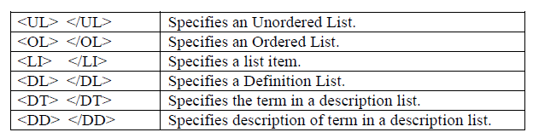
LISTS IN HTML
Lists are the index of items to be appeared in web pages in a specified format.
There are three types of lists
a. Ordered Lists
b. Unordered Lists
c. Description List (or) Definition Lists

Slide 2
ORDERED LIST:
An ordered list starts with the <ol> tag.
Each list item starts with the <li> tag.
The list items will be marked with numbers by default:
The ordered list is also known as the Number List

Slide 3
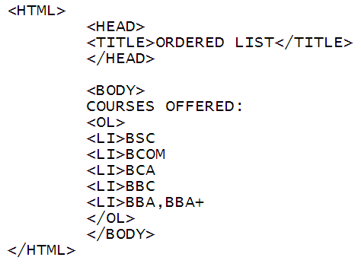
Example :

Slide 4
UNORDERED LIST: An unordered list starts with the <ul> tag. Each list item starts with the <li> tag. The list items will be marked with bullets (small black circles) by default:

Slide 5
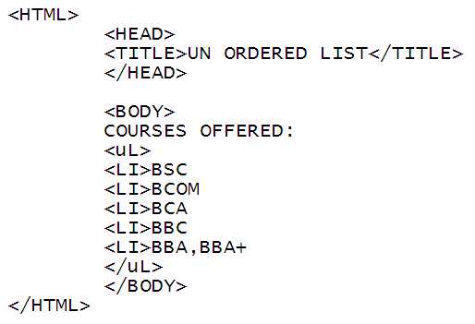
Example:

Slide 6
DESCRIPTION LIST: A description list is a list of terms, with a description of each term. The <dl> tag defines the description list, The <dt> tag defines the term (name), and the <dd> tag describes each term:

Slide 7
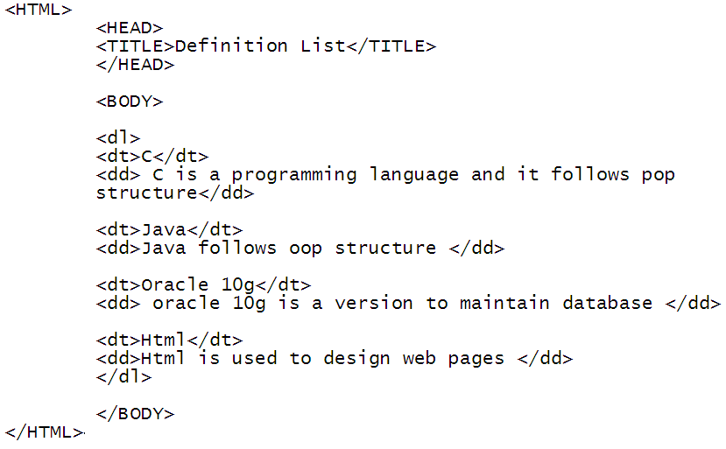
Example:

Slide 8
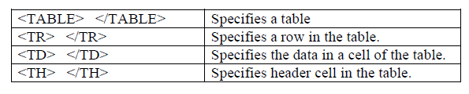
TABLE TAG:
An HTML table is a rectangular grid of rows and columns on a web page, to which you can enter all kinds of information, including text, numbers, links, and images.

Slide 9
Attributes of Table Tag
1. The BORDER attribute in <TABLE> tag tells the visibility of table border.
2. The ROWSPAN attribute in <TR> tag is used to merge the cells vertically.
3. The COLSPAN attribute in <TR> tag is used to merge the cells horizontally.
4. The CELLPADDING attribute in <TABLE> tag specifies the distance between the cell content and cell borders.
5. The CELLSPACING attribute in <TABLE> tag specifies the distance between the cells in a table.

Slide 10
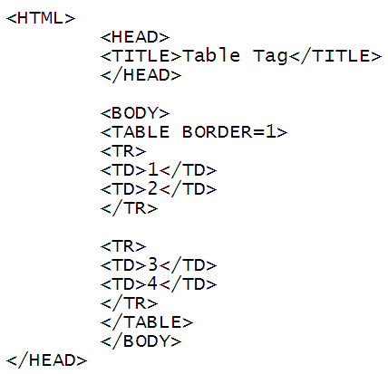
Example 1:

Slide 11
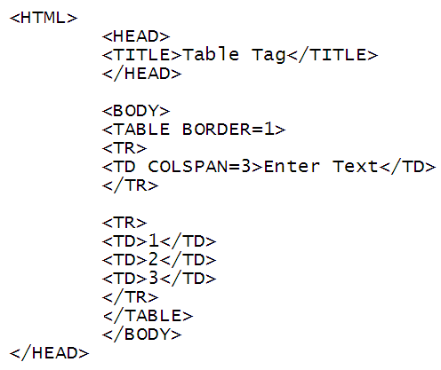
Example 2 ( Colspan ):

Slide 12
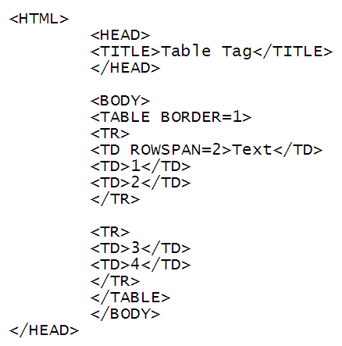
Example 3 (Row span ):

Slide 13
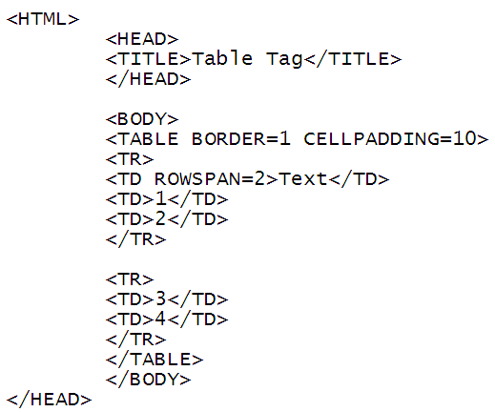
Example 4 (Cell Padding):

Slide 14
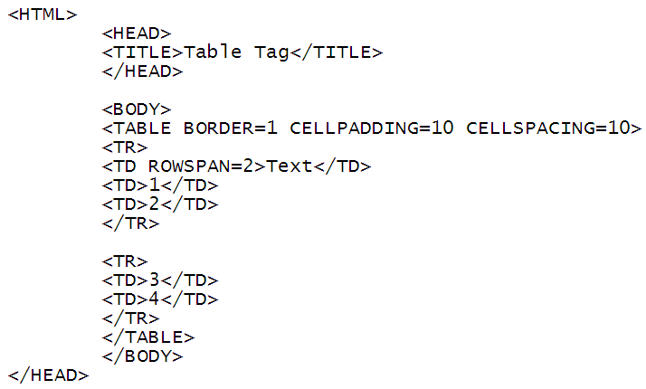
Example 5 (Cell Spacing):

Slide 15
<TH > Tag:
The <th> tag defines a header cell in an HTML table.
An HTML table has two kinds of cells:
Header cells - contains header information (created with the <th> element)
Data cells - contains data (created with the <td> element)
The text in <th> elements are bold and centered by default.
The text in <td> elements are regular and left-aligned by default.

Slide 16
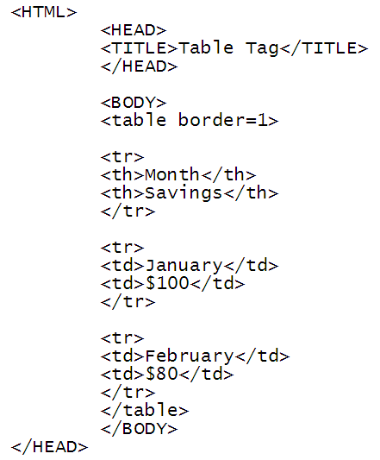
Example:

Slide 17
Design your class time table

